Slide 1
Auto-NBA Milestone 3
Jacob Wheeler, Jaden Ziga, Ryan Hastie

Slide 2
Summary of Auto-NBA
Searches for the best combination of network architecture, bitwidths, and accelerators
Mainly designed for CNNs, but can also be used for DNNs
Finds an architecture, then trains the dataset using that selected architecture

Slide 3
Milestone 3 for Auto-NBA - Path B
Compare how different Auto-NBA configuration parameters affect:
Search time
Training time
Training accuracy

Slide 4
Why Configuration Parameters
Auto-NBA repository lacks sufficient documentation with a small read me file
and a lack of comments within the configuration file
These experiments aim to make it clear which parameters affect accuracy and efficiency

Slide 5
Experimental Setup
CIFAR-10
5% training portion
25 search epochs
25 training epochs
Google Colab T4 GPU

Slide 6
Parameters We Tested
Bitwidth search space
Fixed bitwidth values
Alpha / beta weights
Channel list
Efficiency metric
Number of layers

Slide 7
Experiment 1 - Bitwidth Search Space
Configurations:
C.num_bits_list = [4]
C.num_bits_list = [4, 6]
C.num_bits_list = [4, 6, 8]
Goal:
Compare search time as search space gets larger
Compare training accuracy between the three runs

Slide 8
Experiment 1 - Results
Larger search space increased search time and improved accuracy.
Configuration | Search Time | Train Time | Accuracy
[4] | 55 min | 46 min | 77.917
[4,6] | 1 hr 35 min | 40 min | 81.647
[4,6,8] | 2 hr 17 min | 41 min | 85.536

Slide 9
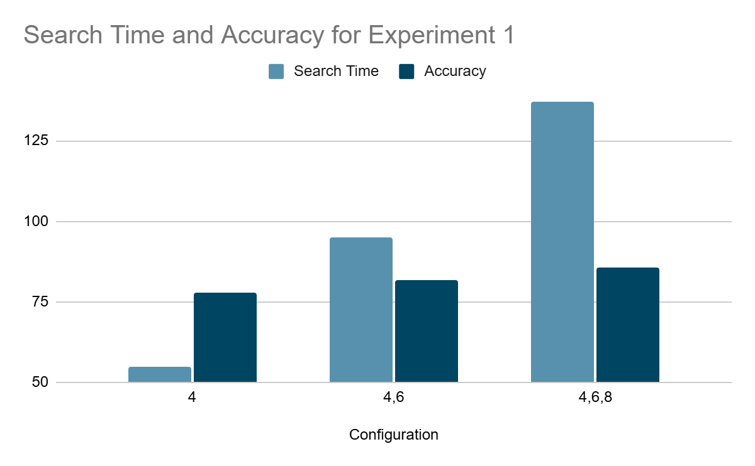

Slide 10
Experiment 2 - Fixed Bitwidth Comparison
Configurations:
4-bit only [4]
6-bit only [6]
8-bit only [8]
Goal:
Compare accuracy and efficiency of fixed 4-bit, 6-bit, and 8-bit models

Slide 11
Experiment 2 - Results
8-bit gave the highest training accuracy.
Configuration | Search Time | Train Time | Accuracy
[4] | 55 min | 46 min | 77.917
[6] | 54 min | 41 min | 84.067
[8] | 54 min | 38 min | 85.714

Slide 12
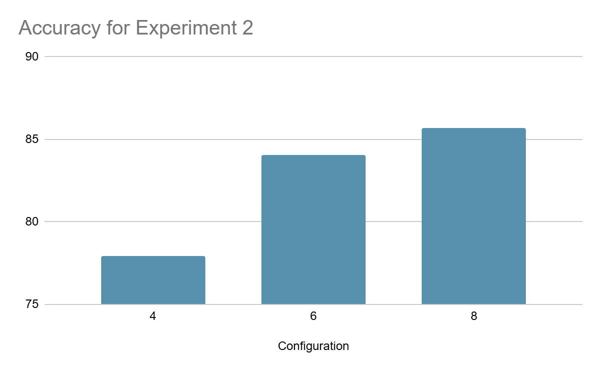

Slide 13
Experiment 3 - Alpha / Beta Weights
Configurations:
alpha = 1, beta = 1
alpha = 0.2, beta = 0.2
alpha = 0.05, beta = 0.05
Goal:
Compare how changing alpha and beta affects search time, training time, and training accuracy

Slide 14
Experiment 3 - Results
The 0.05 / 0.05 setting produced the highest training accuracy.
Configuration | Search Time | Train Time | Accuracy
alpha 1, beta 1 | 2 hr 8 min | 47 min | 83.849
alpha 0.2, beta 0.2 | 2 hr 5 min | 44 min | 84.534
alpha 0.05, beta 0.05 | 2 hr 17 min | 51 min | 85.942

Slide 15
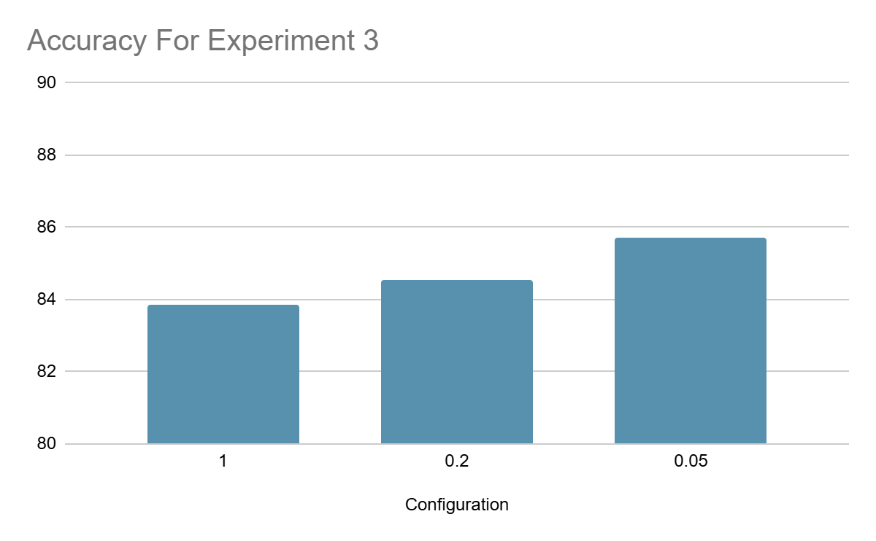

Slide 16
Experiment 4 - Efficiency Metric
Configurations:
C.efficiency_metric = 'latency'
C.efficiency_metric = 'flops'
Goal:
Compare how the efficiency metric changes search time, training time, and training accuracy

Slide 17
Experiment 4 - Results
Latency had a better train time than flops
Configuration | Search Time | Train Time | Accuracy
latency | 2 hr 15 min | 38 min | 84.266
flops | 39 min | 52 min | 82.996

Slide 18
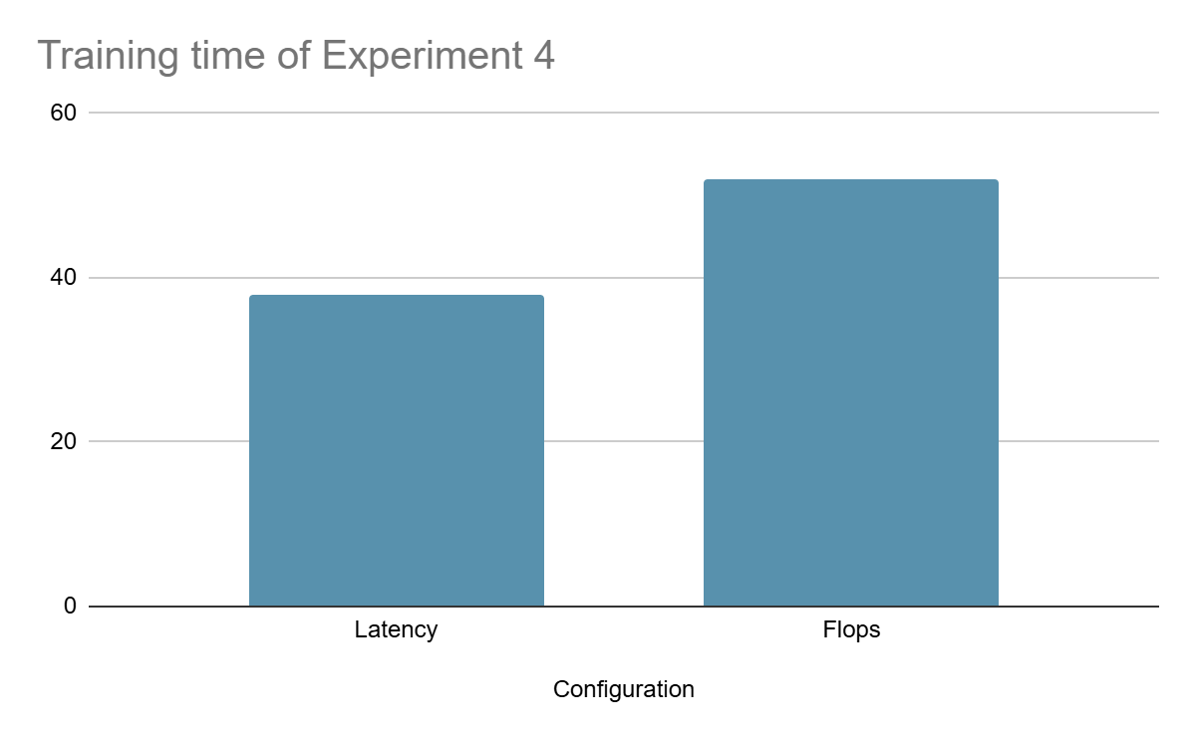

Slide 19
Experiment 5 - Channel List
Configurations:
C.num_channel_list = [16, 24, 32, 64, 112, 184, 352] – standard
C.num_channel_list = [8, 12, 16, 32, 56, 92, 176] – halved
C.num_channel_list = [24, 36, 48, 96, 168, 276, 528] – 1.5x
Goal:
Compare how changing the channel list affects accuracy and efficiency
Search time may also be affected

Slide 20
Experiment 5 - Results
Larger channel sizes improved accuracy, but increased search time. Smaller channel sizes ran faster, but reduced performance.
Configuration | Search Time | Train Time | Accuracy
Standard [16, 24, 32, 64, 112, 184, 352] | 2 hr 1 min | 38 min | 74.345
Halved [8, 12, 16, 32, 56, 92, 176] | 1 hr 43 min | 35 min | 64.722
1.5x [24, 36, 48, 96, 168, 276, 528] | 2 hr 21 min | 35 min | 78.611

Slide 21
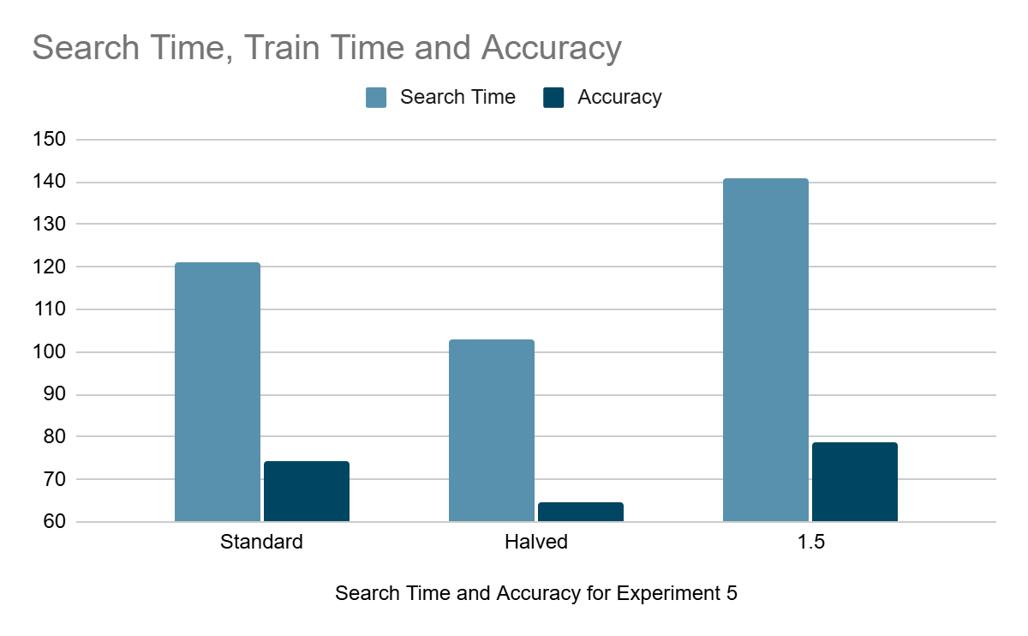

Slide 22
Failed Experiment 6 - Number of Layers
C.num_layer_list
Values to test : [1,4,4,4,4,4,1] (standard configuration
[1,2,2,2,2,2,1] (halved), [1,6,6,6,6,6,1] (1.5)
Completely broke Auto-NBA

Slide 23
Conclusion
Auto-NBA searches for and trains an architecture based on the settings provided
Different settings changed the search time, training time, and training accuracy
Bitwidth settings, alpha/beta weights, the channel list, and the efficiency metric all affected the results
Overall, the configuration choices made a clear difference in performance

